Slide 1


Lecture #0

Slide 2

CAP538
ALGORITHM DESIGN AND ANALYSIS
The Kick Start Session

Slide 3
Course details
L T P – 3 0 2
Textbook
FUNDAMENTALS OF COMPUTER ALGORITHMS by E. HOROWITZ AND S. SAHANI, GALGOTIA
PUBLICATIONS References: DESIGN AND ANALYSIS OF ALGORITHMS by HIMANSHU B. DAVE, PEARSON

Slide 4
Course Assessment Model
Marks break up
Attendance 05
CAP(Three best out of Four Practical) 45
MTE 00
ETP 50
Total 100

Slide 5

The hitch…
Three BURNING questions in mind…
Why are we learning Design and Analysis of Algorithms?
What would we do with it?
What will the course outcome?

Slide 6
Why Analysis and Design of Algorithm
It teaches you the science of evaluating the efficiency of an algorithm.
This enables you to choose the best of various choices.
It creates a platform for cracking the technical rounds in interviews
Being a part of UGC/NET exams , it is very important part of an academician

Slide 7
What we do it with?
Choosing the best optimal solution of a particular problem domain
Choosing alternate approach to solve a particular problem domain if we stuck with existing one
Understand the real life problem domains and solution of those problems

Slide 8
The course contents
Unit I
Introduction: Elementary Data Structures, Basic computational models, Analysis of algorithms: best case, average case and worst-case behavior, Asymptotic Notations: Big O Notation, Recursion, Recurrence relations to analyze recursive algorithms
Unit II
Divide and Conquer and Greedy Method : Divide and Conquer: General Method, Binary Search, Merge Sort, Quick Sort, Arithmetic with large integers, Greedy Method: General Method, Knapsack problem, Minimal Spanning Trees - Prim's and Kruskal's Algorithm, Single Source Shortest Paths
Unit III
Dynamic Programming and Backtracking : Dynamic Programming: General Method, Chained Matrix Multiplication, Optimal Storage on Tapes, All-Pairs Shortest Paths, Optimal Binary Search Trees, Backtracking: General Method, the 8-Queens Problem, Graph Coloring, Hamiltonian Cycles

Slide 9
The course contents…continued
Unit IV
Branch and Bound and Pattern Matching : Branch and Bound: General Method, 0/1 Knapsack problem, Travelling Salesperson, Design of algorithms for Pattern Matching problems: Brute Force, Knuth-Morris-Pratt, Boyer Moore algorithms, Huffman Coding and Data compression problems
Unit V
Lower Bound Theory and Approximation : Comparison tree, Oracles and Adversary arguments, Lower Bounds through Reductions, Approximation Basics, Task Scheduling, Bin Packing
Unit VI
Intractable Problems : Basic Concepts, Non-deterministic Algorithms, NP Completeness, Examples of NP-Hard and NP-Complete problems, Cook's Theorem, Problem Reduction

Slide 10
The course outcome…
CO1 :: Understand the need of different algorithm design techniques
CO2 :: Design and implement algorithms by using divide and conquer, greedy approach, dynamic programming and backtracking
CO3 :: Analyze the asymptotic performance of algorithms
CO4 :: Apply specific algorithms for solving a number of computational problems like sorting, searching, shortest-path and graph problems

Slide 11

Next : Introduction to ALGORITHM DESIGN AND ANALYSIS

Slide 12
Poll
What is the L T P of the course :
3 0 0
3 0 2
2 0 3
0 0 3

Slide 13
Algorithm
An algorithm is a step-by-step procedure for solving a problem in a finite amount of time.

Slide 14
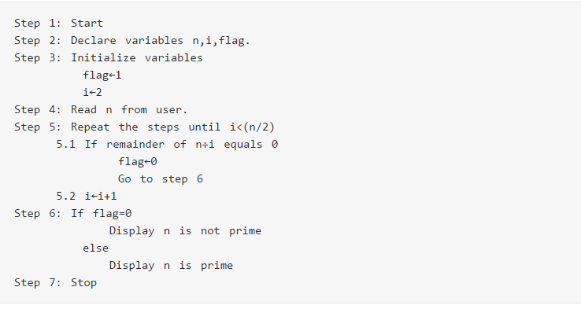
Example
Algorithm to check whether a number entered by user is prime or not.

Slide 15
Code……
?

Slide 16
Write an algorithm to find the Fibonacci series till term≤1000

Slide 17
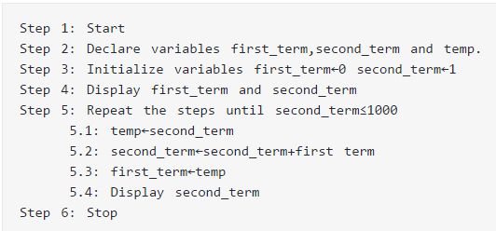

Slide 18
Code
?

Slide 19
Data Structures
A data structure is a specialized format for organizing and storing data .
General data structure types include the array, the file, the record, the table, the tree, and so on
Any data structure is designed to organize data to suit a specific purpose so that it can be accessed and worked with in appropriate ways.

Slide 20
Some Examples of Data structures
There are numerous types of data structures, generally built upon simple primitive data type
Primitive types
Composite types or Non-primitive type
Abstract data types

Slide 21
Primitive types
Boolean, true or false.
Character
Floating-point, single-precision real number values.
Double, a wider floating-point size.
Integer, integral or fixed-precision values.
String, a sequence of characters.
Reference (also called a pointer or handle), a small value referring to another object's address in memory, possibly a much larger one.

Slide 22
Composite types or Non-primitive type
(aggregate data type)
Array
Record (also called tuple or structure)
Union

Slide 23
Abstract data types
Container
List
Associative array
(associative array, map, symbol table, or dictionary is an abstract data type composed of a collection of (key, value) pairs, such that each possible key appears at most once in the collection.)
Multimap
(a multimap (sometimes also multihash or multidict) is a generalization of a map or associative array abstract data type in which more than one value may be associated with and returned for a given key)

Slide 24
Continue…..
Set
Multiset (Bag)
Stack
Queue
Double-ended queue
Priority queue
Tree
Graph

Slide 25

Linear data structures
Array
Linked List
Stack
Queue
Tree
Graph

Slide 26
Poll
Array falls under which data type?
Primitive
Non-Primitive
Abstract
All

Slide 27


